Slide 1
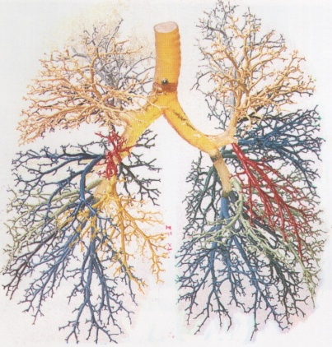

The Ensifentrine Story: A Bifunctional Therapy For
Respiratory Diseases
Professor Clive Page, OBE, BSc, PhD, FRSB, FBPhS (Hon), FFPM (Hon)
Emeritus Professor of Pharmacology
Institute of Pharmaceutical Science
King’s College London

Slide 2
Conflicts of interest
I have received Financial support as grants for research, attending meetings and fees for speaking and consulting from Eurodrug, Recipharm, Angellini, Inthelia, Ananda Pharma, Heparin Therapeutics Ltd and EpiEndo

Slide 3
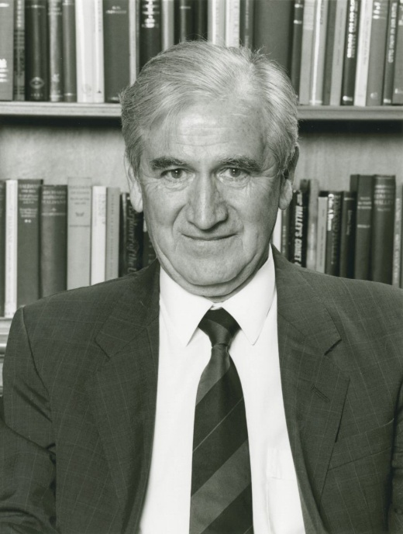
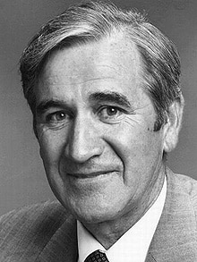
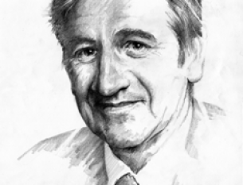
Sir DAVID JACK – THE “GODFATHER” OF BRONCHDILATORS

Slide 4


Slide 5
CURRENT TREATMENT OPTIONS
Bronchodilators
Short-acting
Long-acting
Fixed combinations
β-agonists:
Salbutamol
Levalbuterol
Terbutaline
Pirbuterol
Antimuscarinics:
Ipratropium
Oxitropium
β-agonists:
Salmeterol
Formoterol
Olodaterol
Indacaterol
Antimuscarinics:
Tiotropium
Aclidinium
Umeclidinium
Glycopyronium
Xanthines:
Theophylline
Doxophylline
LABA/LAMA:
Salbutamol + ipratropium
Indacaterol + glycopyrronium
Vilanterol + umeclidinium
Aclidinium + formoterol
LABA/ICS:
Formoterol + budesonide
Salmeterol + fluticasone
Formoterol + mometasone
Vilanterol + fluticasone
Notes:
5

Slide 6


Need for New Therapies
Bronchodilators
(First Line Treatment)
Existing drug class
New drug class
Anti-Inflammatories
Anti-Muscarinics
Beta2-Agonists
Inhaled CorticoSteroids
PDE4 Inhibitors
SAMA
(e.g.
Ipratropium)
LAMA
(e.g. Spiriva)
SABA
(e.g. Albuterol)
LABA
(e.g. Serevent)
ICS
PDE4
(e.g. Roflumilast)
Bronchodilator
Anti-Inflammatory
Not indicated as monotherapy
Rapid Onset
–
Black box warning
Well Tolerated
Pneumonia
Broad Patient Population
?
Many patients treated with approved COPD drugs/combinations do not experience significant
improvements in quality of life and continue to suffer from significant symptoms

Slide 7
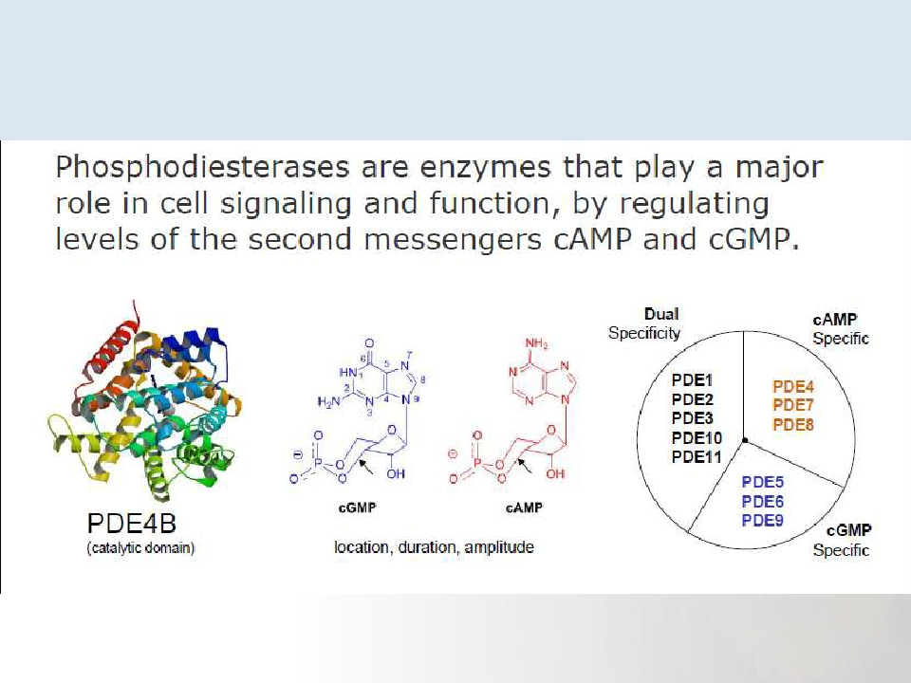
Phosphodiesterases

Slide 8
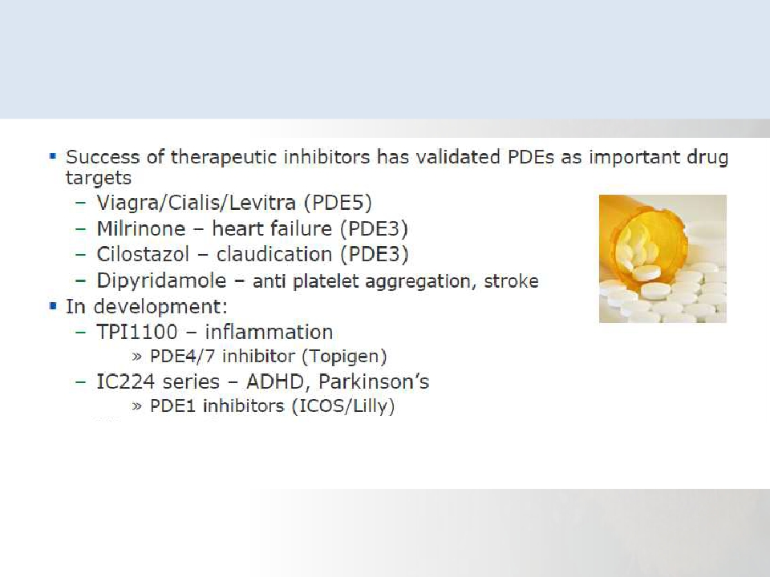
Phosphodiesterases as drug targets
PDE4 inhibitors – roflumilast approved for treatment of COPD
Apremilast for the treatment of psoriatic arthritis

Slide 9
The pharmacology and duration of action of
novel Trequinsin-like phosphodiesterase inhibitors
V Boswell-Smith, D. Spina, M. Comer, C.P. Page,
A.W. Oxford & D. Jack
Institute of Pharmaceutical Science
King’s College London.,
Vernalis Pharmaceuticals Ltd, United Kingdom.

Slide 10

Ensifentrine (RPL554): First-in-Class “Bifunctional” Bronchodilator/Anti-inflammatory drug in a Single Molecule
Bronchodilation
Anti-Inflammatory
SAMA | LAMA
SABA | LABA
PDE3
ICS
PDE4
RPL554
Dual-enzyme inhibitor
Bronchodilator AND
anti-inflammatory
in a single compound
Airway Smooth Muscle
Inflammatory
Epithelial Cells
Cells
Impacts 3 Key Mechanisms in Respiratory Disease:
Eosinophils
PDE4
Epithelial cells PDE3, PDE4
Macrophages PDE3, PDE4
PDE3, PDE4
PDE3, PDE4
Relaxation
Neutrophils
PDE4
Lymphocytes PDE3, PDE4
Fibroblasts
PDE4
CFTR Activation
Increased
bronchodilation
Increased
anti-inflammatory effects
Increased
mucociliary clearance

Slide 11
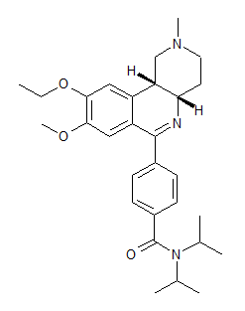
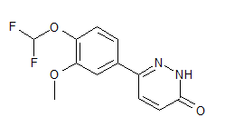
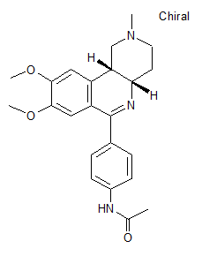
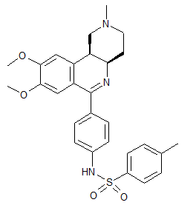
Earlier attempts to develop PDE3/4 inhibitors for respiratory disease
failed because of side-effects and short-duration of action
 | Pumafentrine | Zardaverine | Ben(z)afentrine | Tolafentrine
Structure
IC50 PDE3 | 28nM | 110nM | 1.74μM (platelet)
IC50 PDE4 | 7nM | 210nM | 1.76μM (neutrophil)
 | oral Ph2 for asthma Safety and tolerability expectations met in Phase 1 study Anti-inflammatory effect as TNF-α reduction (whole blood ex vivo) | inhaled Ph2 for asthma Modest & short lived bronchodilation (inhalation) Nausea and vomiting | Inhaled, i.v. Dose dependent bronchodilation (inhaled and iv) in HV at doses that had no effect on blood pressure or heart rate | Ph1 for pulmonary hypertension/asthma
Reason for discontinuation | Active metabolite (discontinued Nov 2002) | Duration of action? GI Side effects? | Duration of action? | Unknown
Currently no approved PDE3 or dual PDE3/4 inhibitors for respiratory disease

Slide 12
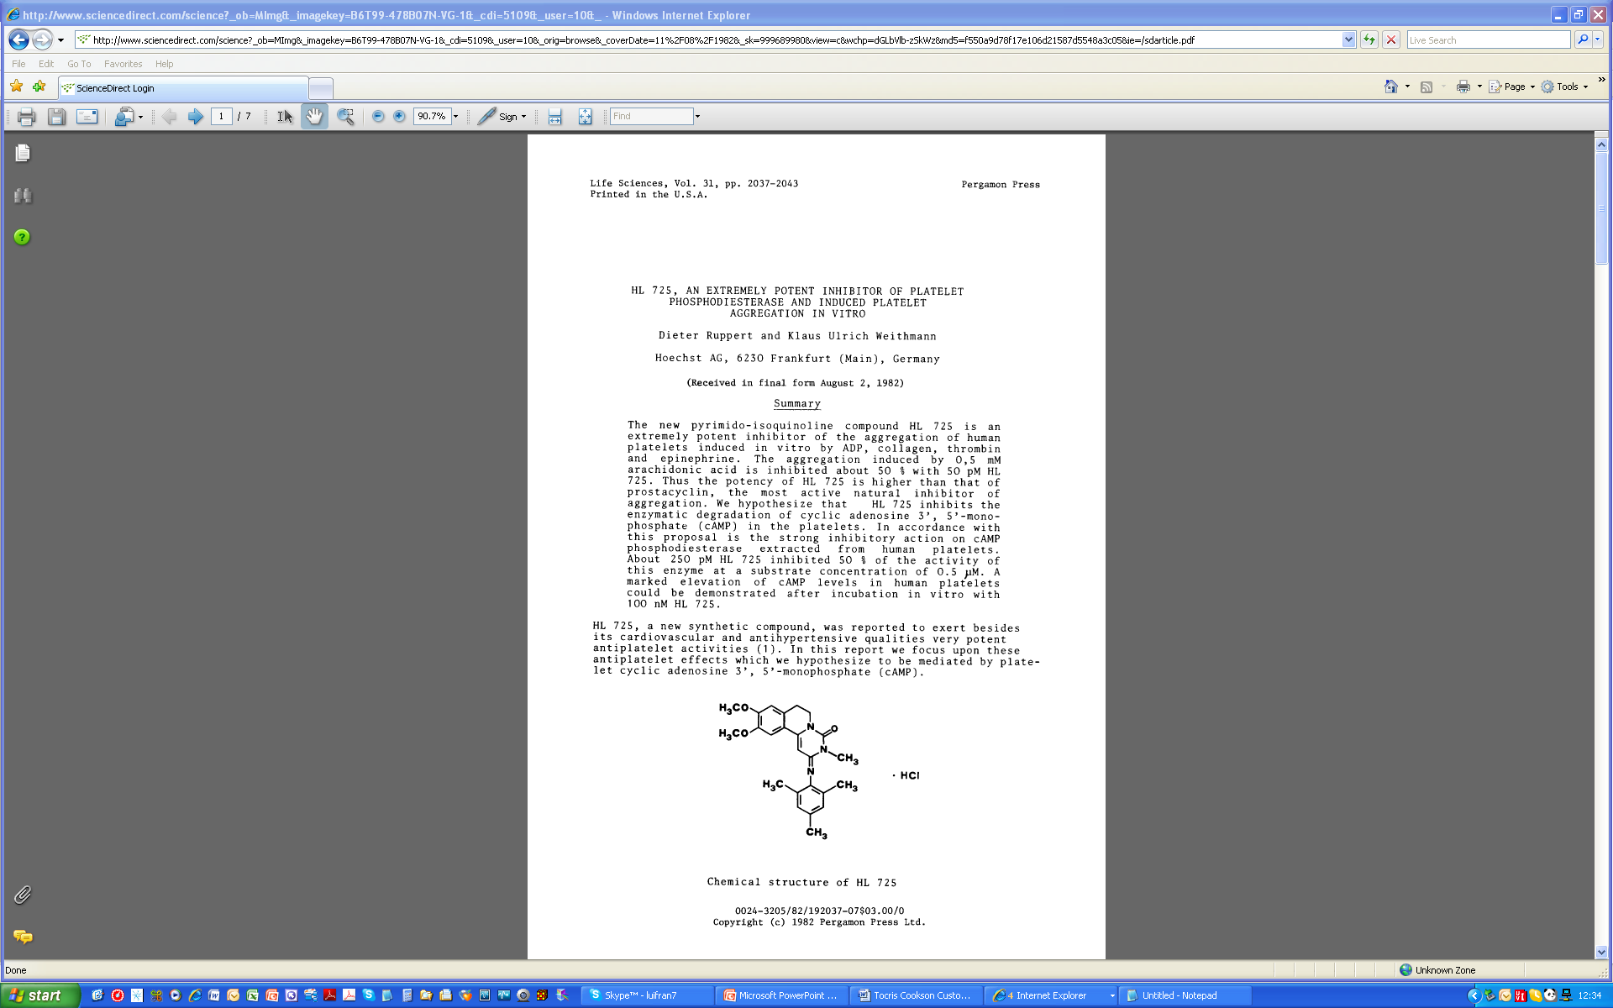
Pharmacophore - Trequinsin
History
A cardiovascular drug discovered by German scientists at Hoechst AG in the early 1980s
Original code name: HL 725
Source: Ruppert and Weithmann (1982) HL 725, an extremely potent inhibitor of platelet phosphodiesterase and induced platelet aggregation in vitro. Life Sci. 31 2037.

Slide 13
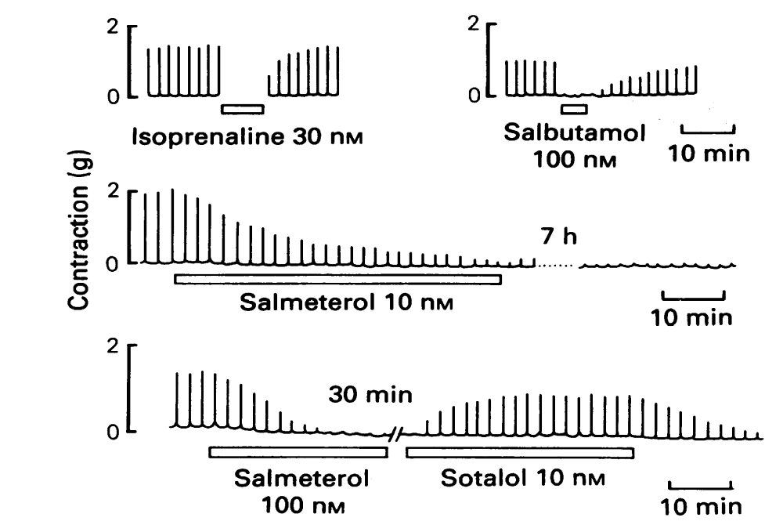
Effects of isoprenaline, salbutamol and salmeterol on electrically stimulated, superfused, guinea-pig isolated trachea

Slide 14
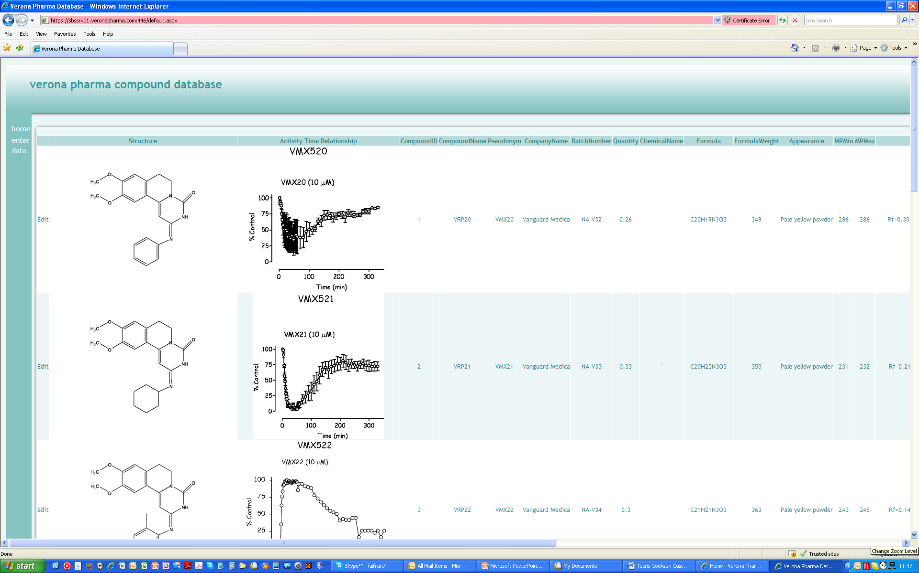
Examples of Chemistry and SAR

Slide 15
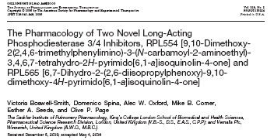
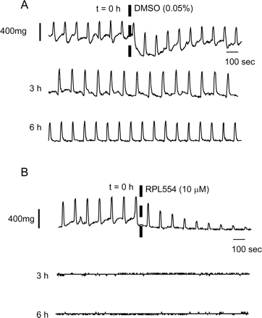
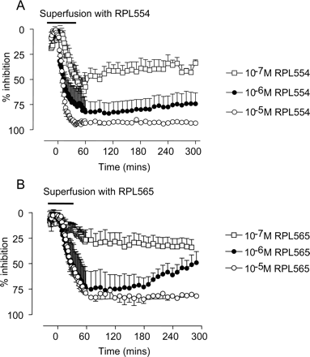

Slide 16
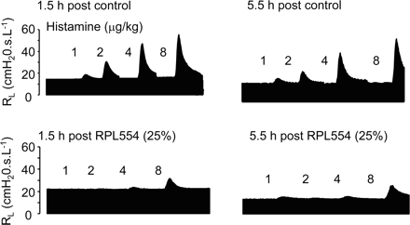
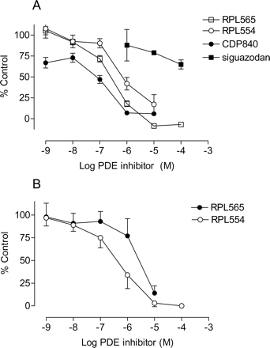

Slide 17
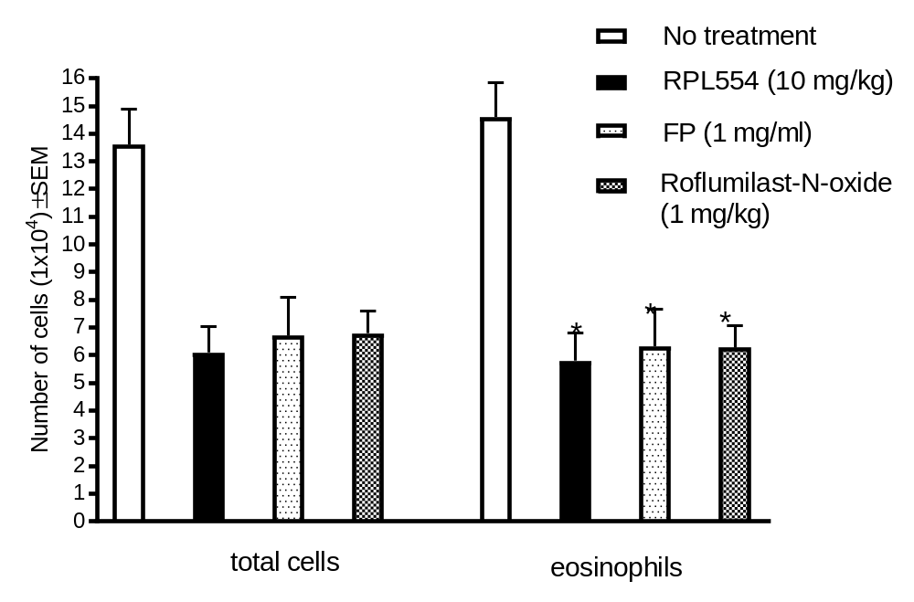
EFFECT OF TREATMENT WITH RPL554 (10 mg/kg, ip), FLUTICASONE PROPIONATE (1 mg/ml; intranasal) OR ROFLUMILAST N-OXIDE (1 mg/kg, ip) ON ALLERGEN-INDUCED EOSINOPHILIA.

Slide 18
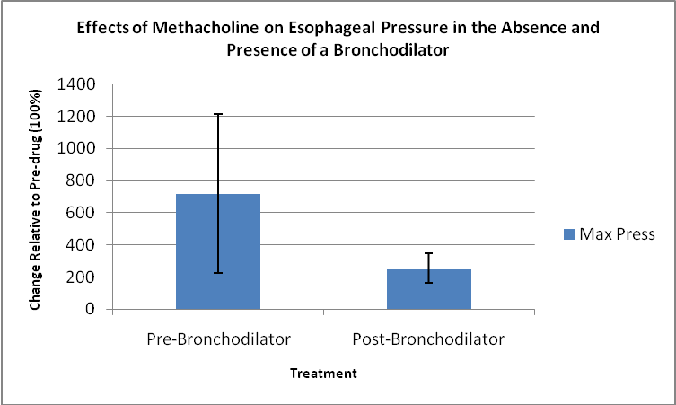
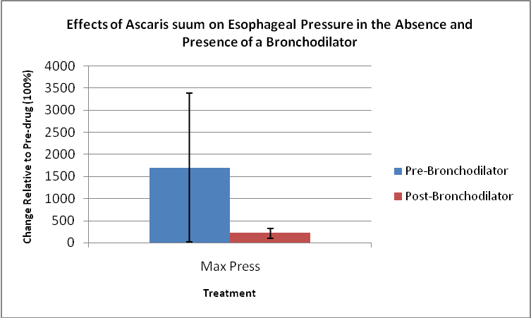
Effect of RPL554 on Allergic and Methacholine-Induced Bronchoconstriction in Primates

Slide 19
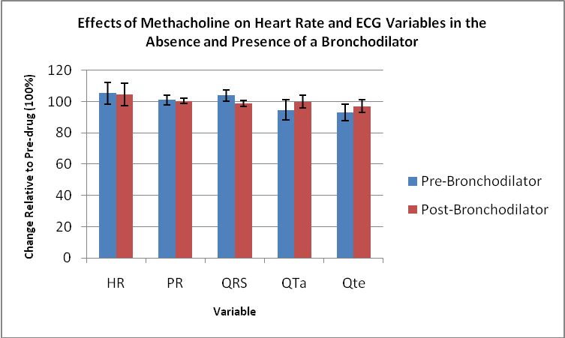
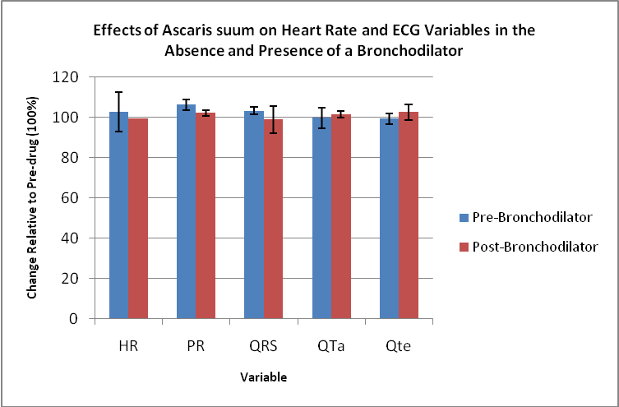
Effect of RPL554 on Allergic and Methacholine-Induced Bronchoconstriction in Primates
Spina et al., 2025

Slide 20
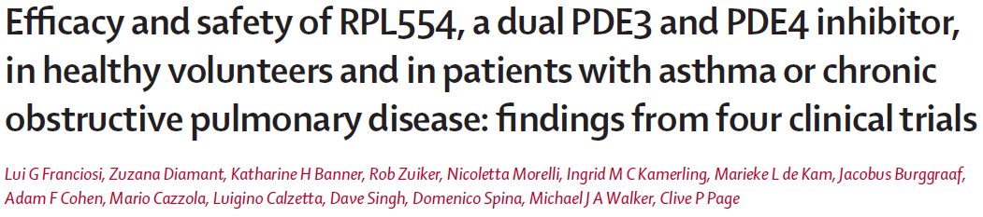

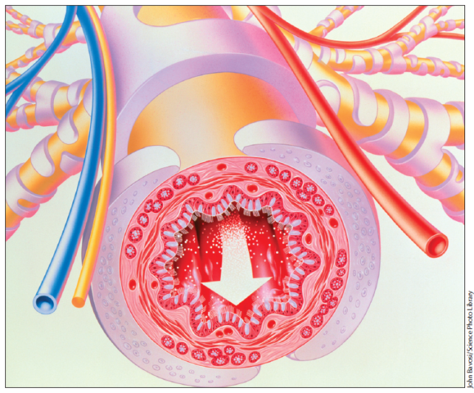


Slide 21
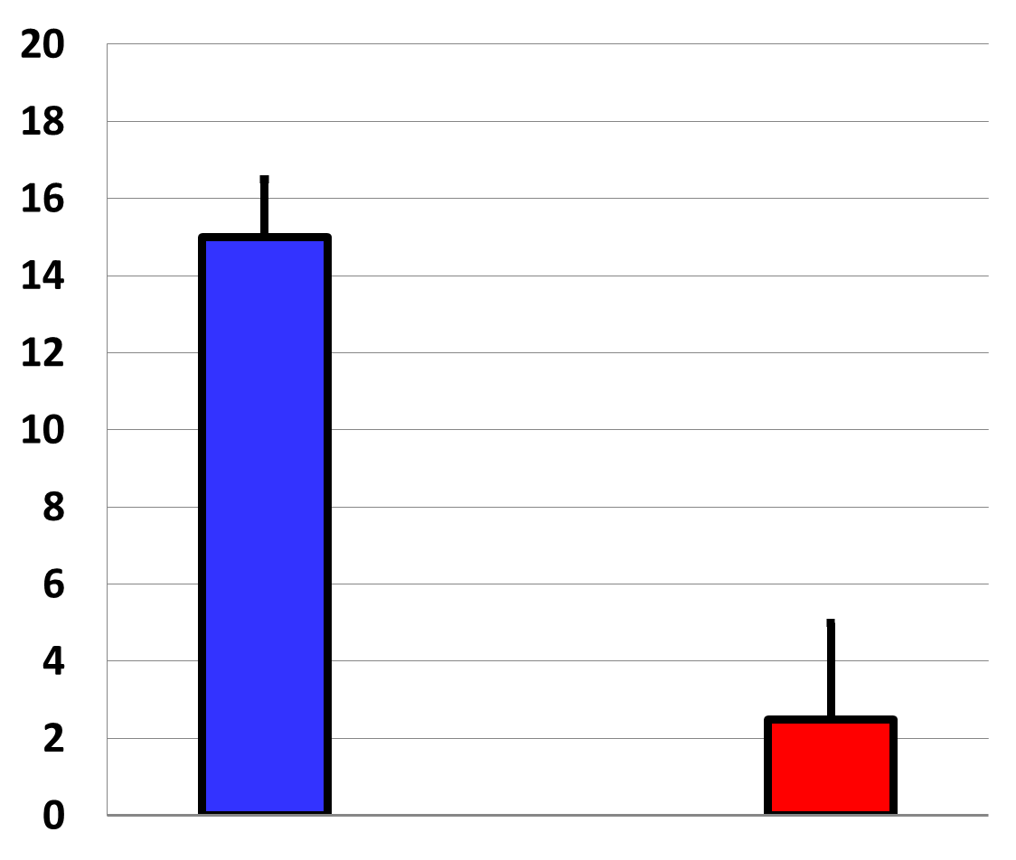
Results: RPL554 produced a pronounced bronchodilation in asthmatics (n=10)
FEV1
% max increase from baseline
Mean ± SEM
3
RPL554
0.018 mg/kg
Placebo
RPL554 produced a mean maximal increase in FEV1 of 0.5 Litres, or approx. 15% increase from baseline vs. placebo (p <0.0001) at approx. 60 minutes post-dose
Notes:
There was a rapid-onset bronchodilation, max at 1 h post-inhalation (and may be underestimated since at that timepoint the methacholine PC20 was performed)

Slide 22

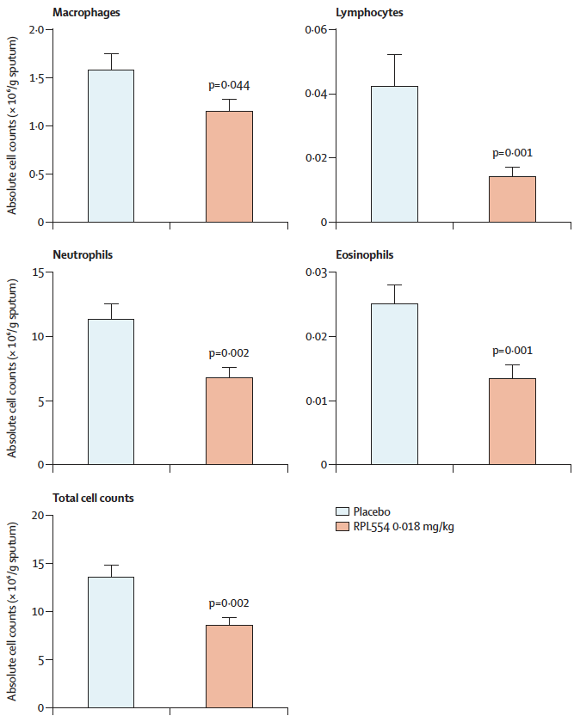
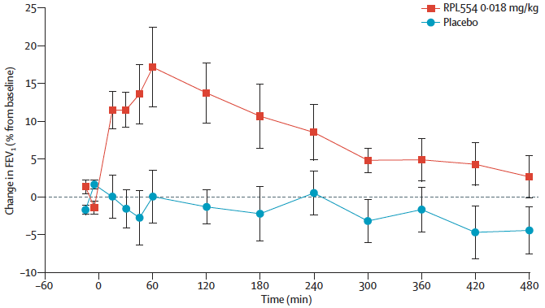
After a 6-day treatment with ensifentrine in healthy subjects, the anti-inflammatory effect was evident. Although the reduction in the percentage of neutrophils in induced sputum 6 hours after the LPS challenge was partial, there was a significant decrease in the absolute numbers of neutrophils, macrophages, eosinophils, and lymphocytes.
One dose of nebulised ensifentrine (0.018 mg/kg) showed substantial bronchodilator effects in patients with mild to-moderate COPD
Lancet Resp Med 2013; 1: 714-27

Slide 23
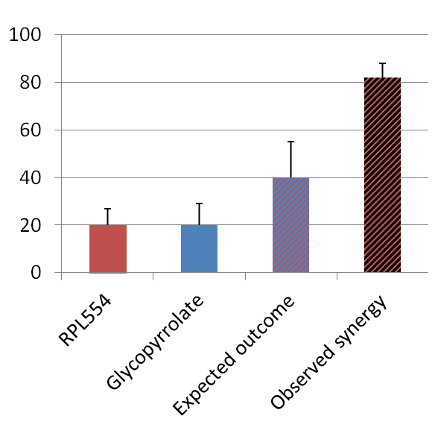
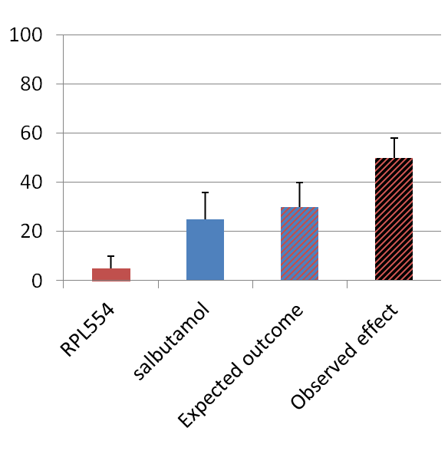
Interaction with existing bronchodilators
Combination with an anti-muscarinic agent
Synergy = “1 + 1 = 3”
Combination with a beta2 -agonist
Additive effect = “1 + 1 = 2”
% max bronchodilation
% max bronchodilation
P<0.05
P=N.S.
Calzetta et al, 2013

Slide 24
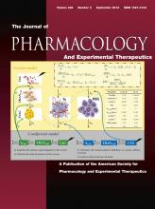
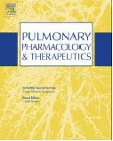
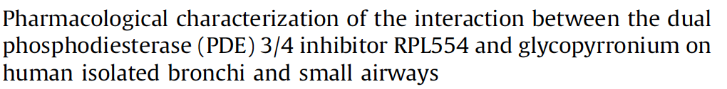
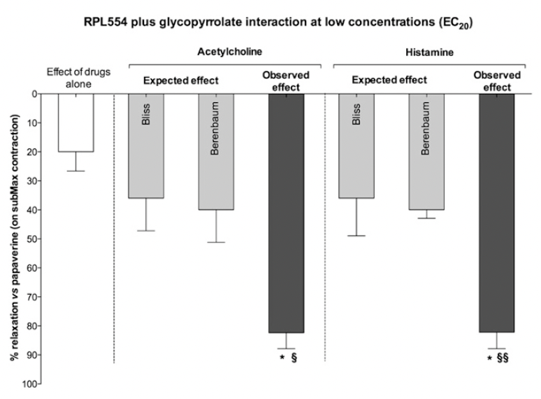
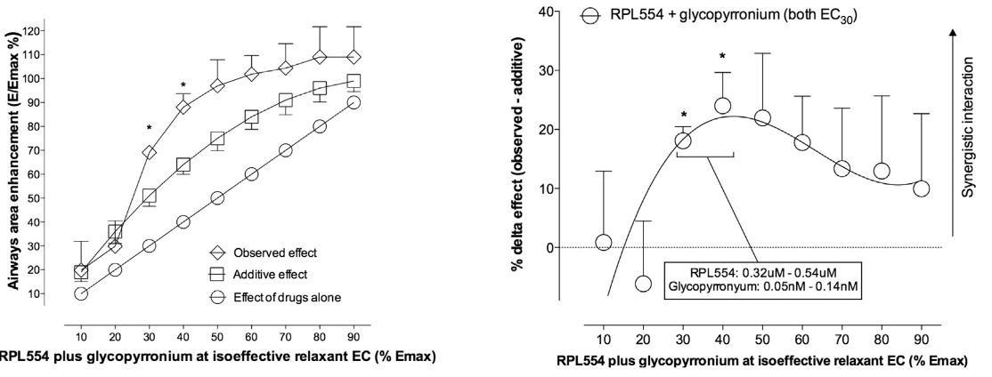
The concomitant administration of low concentrations of ensifentrine (RPL554) and glycopyrrolate at EC20 levels produced a significant synergistic effect on isolated bronchial rings precontracted with acetylcholine and histamine.
Ensifentrine (RPL554) and glycopyrronium both induced a concentration-dependent relaxation of human bronchioles and abolished the contractile tone induced by carbachol. When used together at low-to-middle concentrations (EC30 to EC40), they produced a synergistic relaxant response on small airways, enhancing the relaxant effect and significantly increased the lumen area (respectively 21.05 ± 4.02% over the additive effect (P < 0.05); 69.08 ± 2.41% over the additive response (P < 0.05).
JPET 346:414-423 (2013)
PPT 32 (2015) 15-23

Slide 25

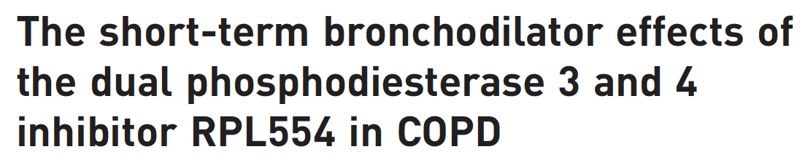

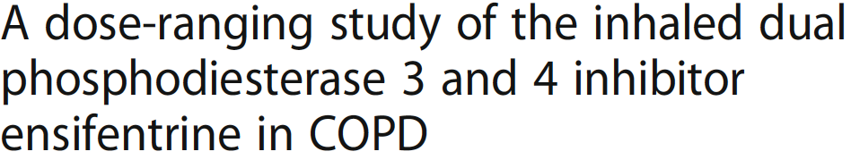
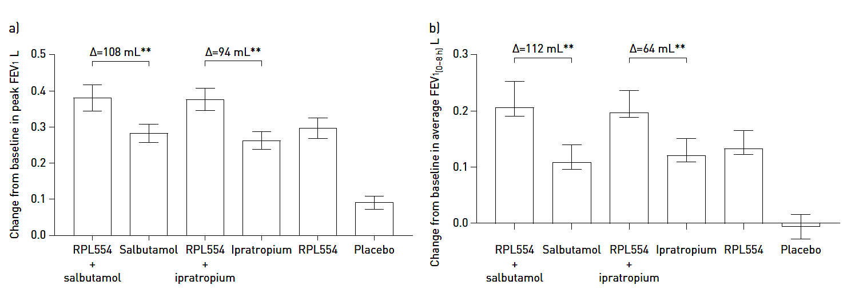
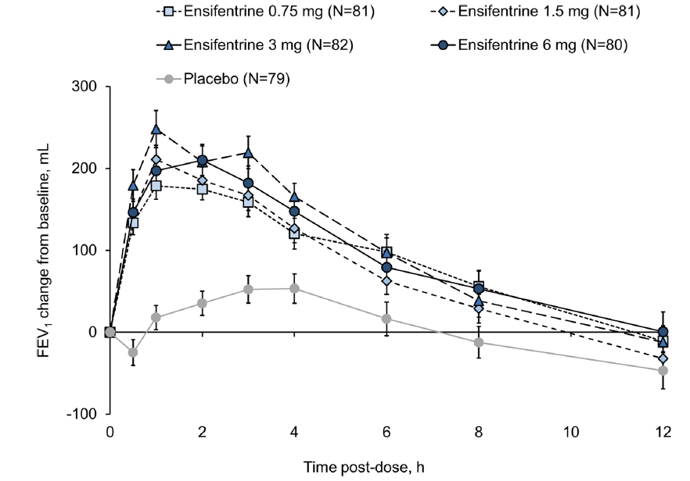
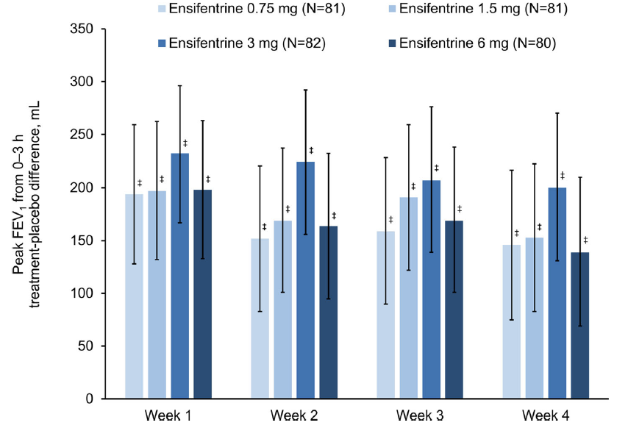
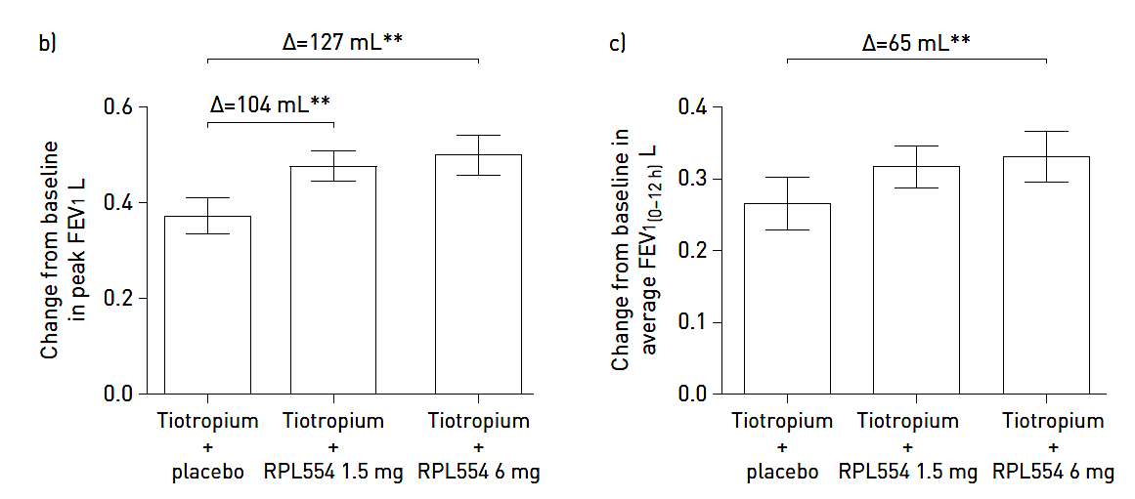
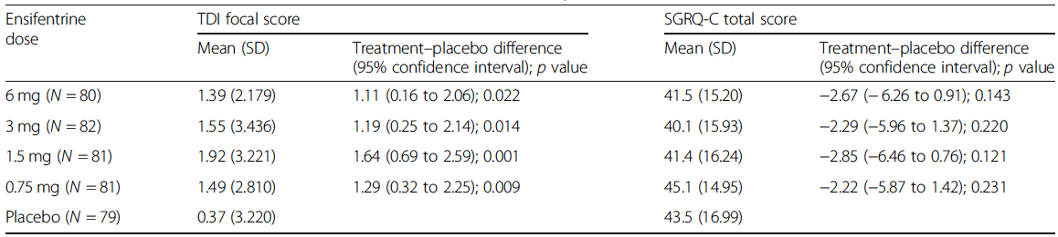
Ensifentrine with short- or long-acting bronchodilators, significantly improved mean peak FEV1 and average FEV1(0-8h), along with other functional parameters, compared to the monocomponents.
In a four-week Phase IIb study, all four ensifentrine doses significantly improved bronchodilation, symptoms, and were well tolerated.
ERJ 2018; 52: 1801074
Resp Res. (2020) 21:47

Slide 26
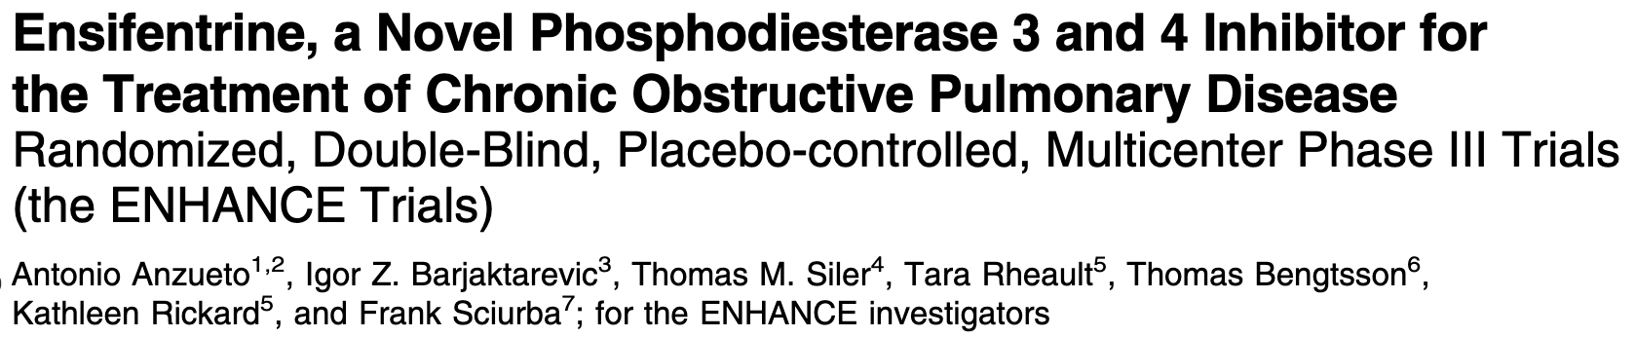
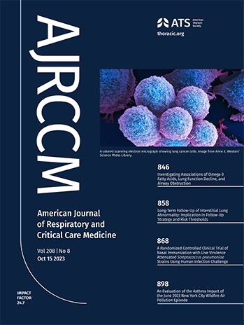
ENHANCE-1 and ENHANCE-2 Trials Summary
Phase III, multicenter, randomized, double-blind, parallel-group, placebo-controlled trials.
Symptomatic, moderate to severe COPD (Current or former smokers).
ENHANCE-1 & ENHANCE-2: 5:3 ratio to twice-daily ensifentrine 3 mg or placebo over 24 weeks via standard jet nebulizer (PARI).
  ENHANCE-1 Subset: 48-week subset randomized in a 3:1 ratio.
Trial Duration:24 or 48 weeks (ENHANCE-1 only).
Totals of 760 (ENHANCE-1) and 789 (ENHANCE-2) patients were randomized and treated, respectively. 69% and 55% receiving concomitant long-acting muscarinic antagonists or long-acting b2-agonists.

Slide 27
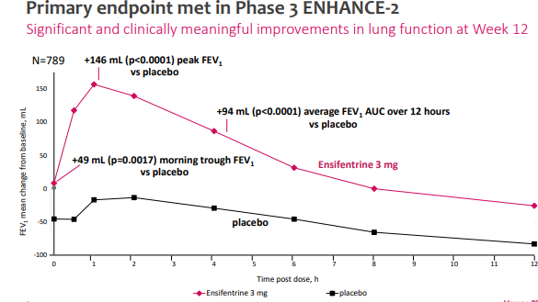

Slide 28
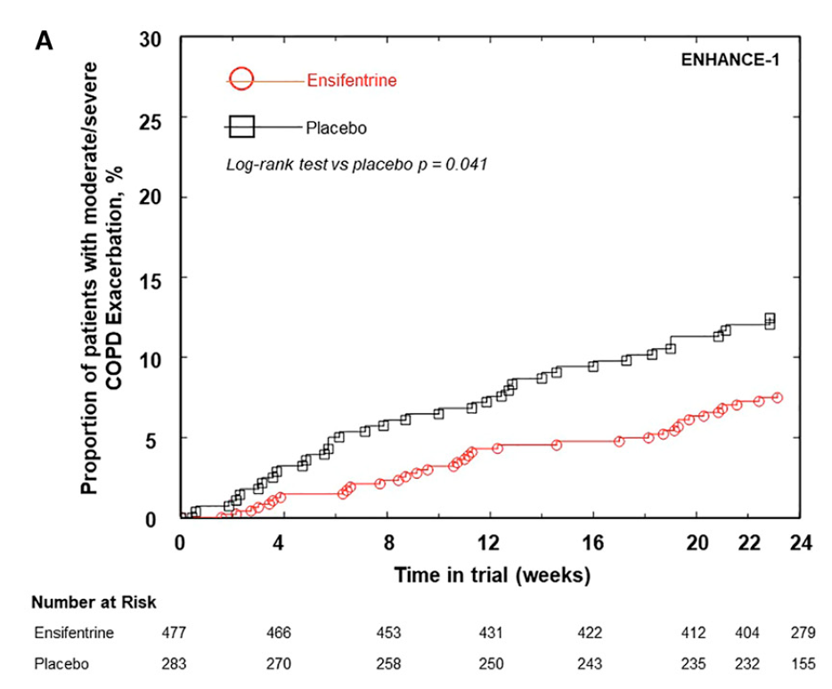
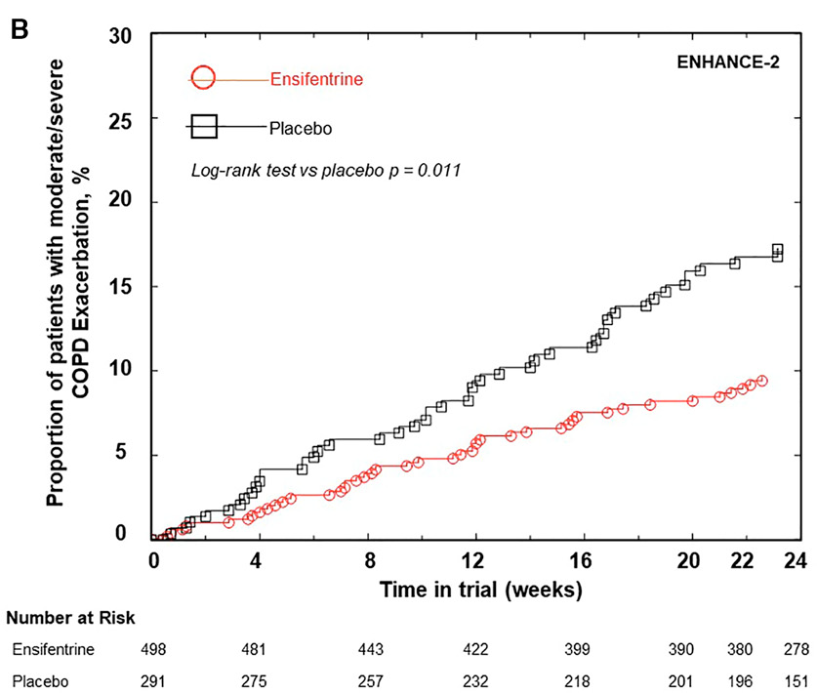
Am J Respir Crit Care Med 208 (2023) 406–416

Slide 29
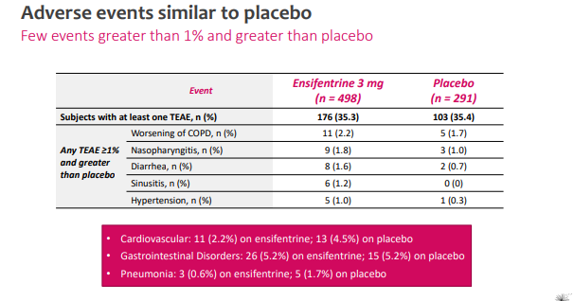

Slide 30
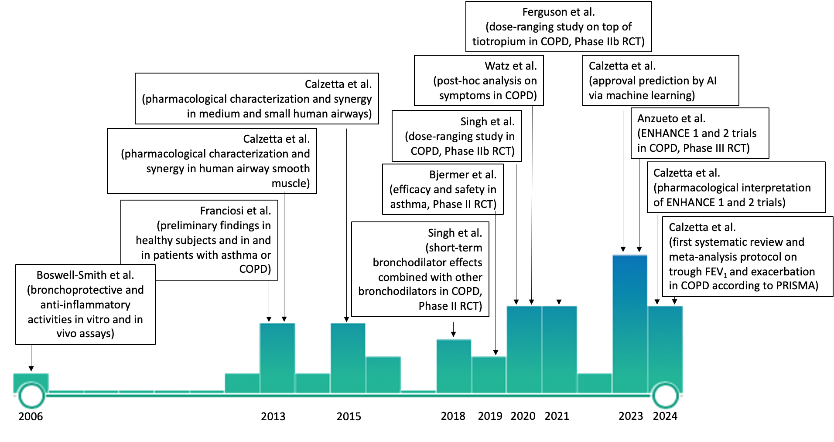
Calzetta L and Rogliani P. Pulm Pharmacol Ther. 2024

Slide 31
Ensifentrine Approved by the FDA on June 26th 2024 for the maintenance
treatment of COPD
Now marketed in the USA under the Trade Name Ohtuvayre
(a first in class medicine combining anti-inflammatory and bronchodilator
activity in a single molecule)
Already been multiple prescriptions filled up to Q12 2026
Ongoing clinical trials in patients with asthma, non-cystic fibrosis
bronchiectasis and cystic fibrosis
Ongoing clinical trials of combination product of inhaled ensifentrine and
glycopyrollate

Slide 32


Acknowledgements
Everyone at the
Institute of Pharmaceutical Science,
King’s College London
(Dr Dom Spina, Dr Victoria Boswell-Smith, Dr Simon Pitchford, Professor Miraz Rahman)
Verona Pharma Ltd (Professor Michael Walker and Dr Lui Franciosi)
Sir David Jack, Dr Alec Oxford
Tor Vergata University, Rome (Professor Mario Cazzola and Dr Luigi Calzetta)

Slide 33
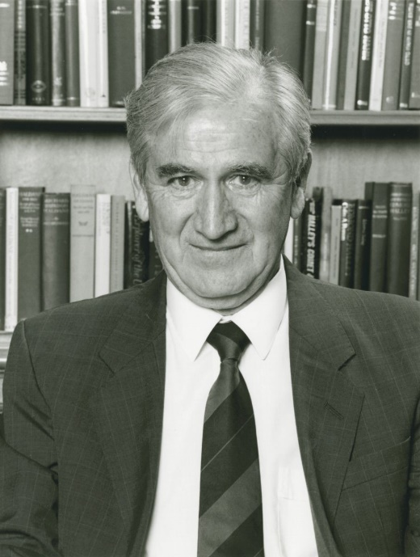
Sir David Jack
CBE, FRS, FRSE

